Slide 1
Introduction ELIXIR and NeLS
Erik Hjerde
ELIXIR Norway, Norwegian e-infrastructure for Life Sciences and usegalaxy.no

Slide 2
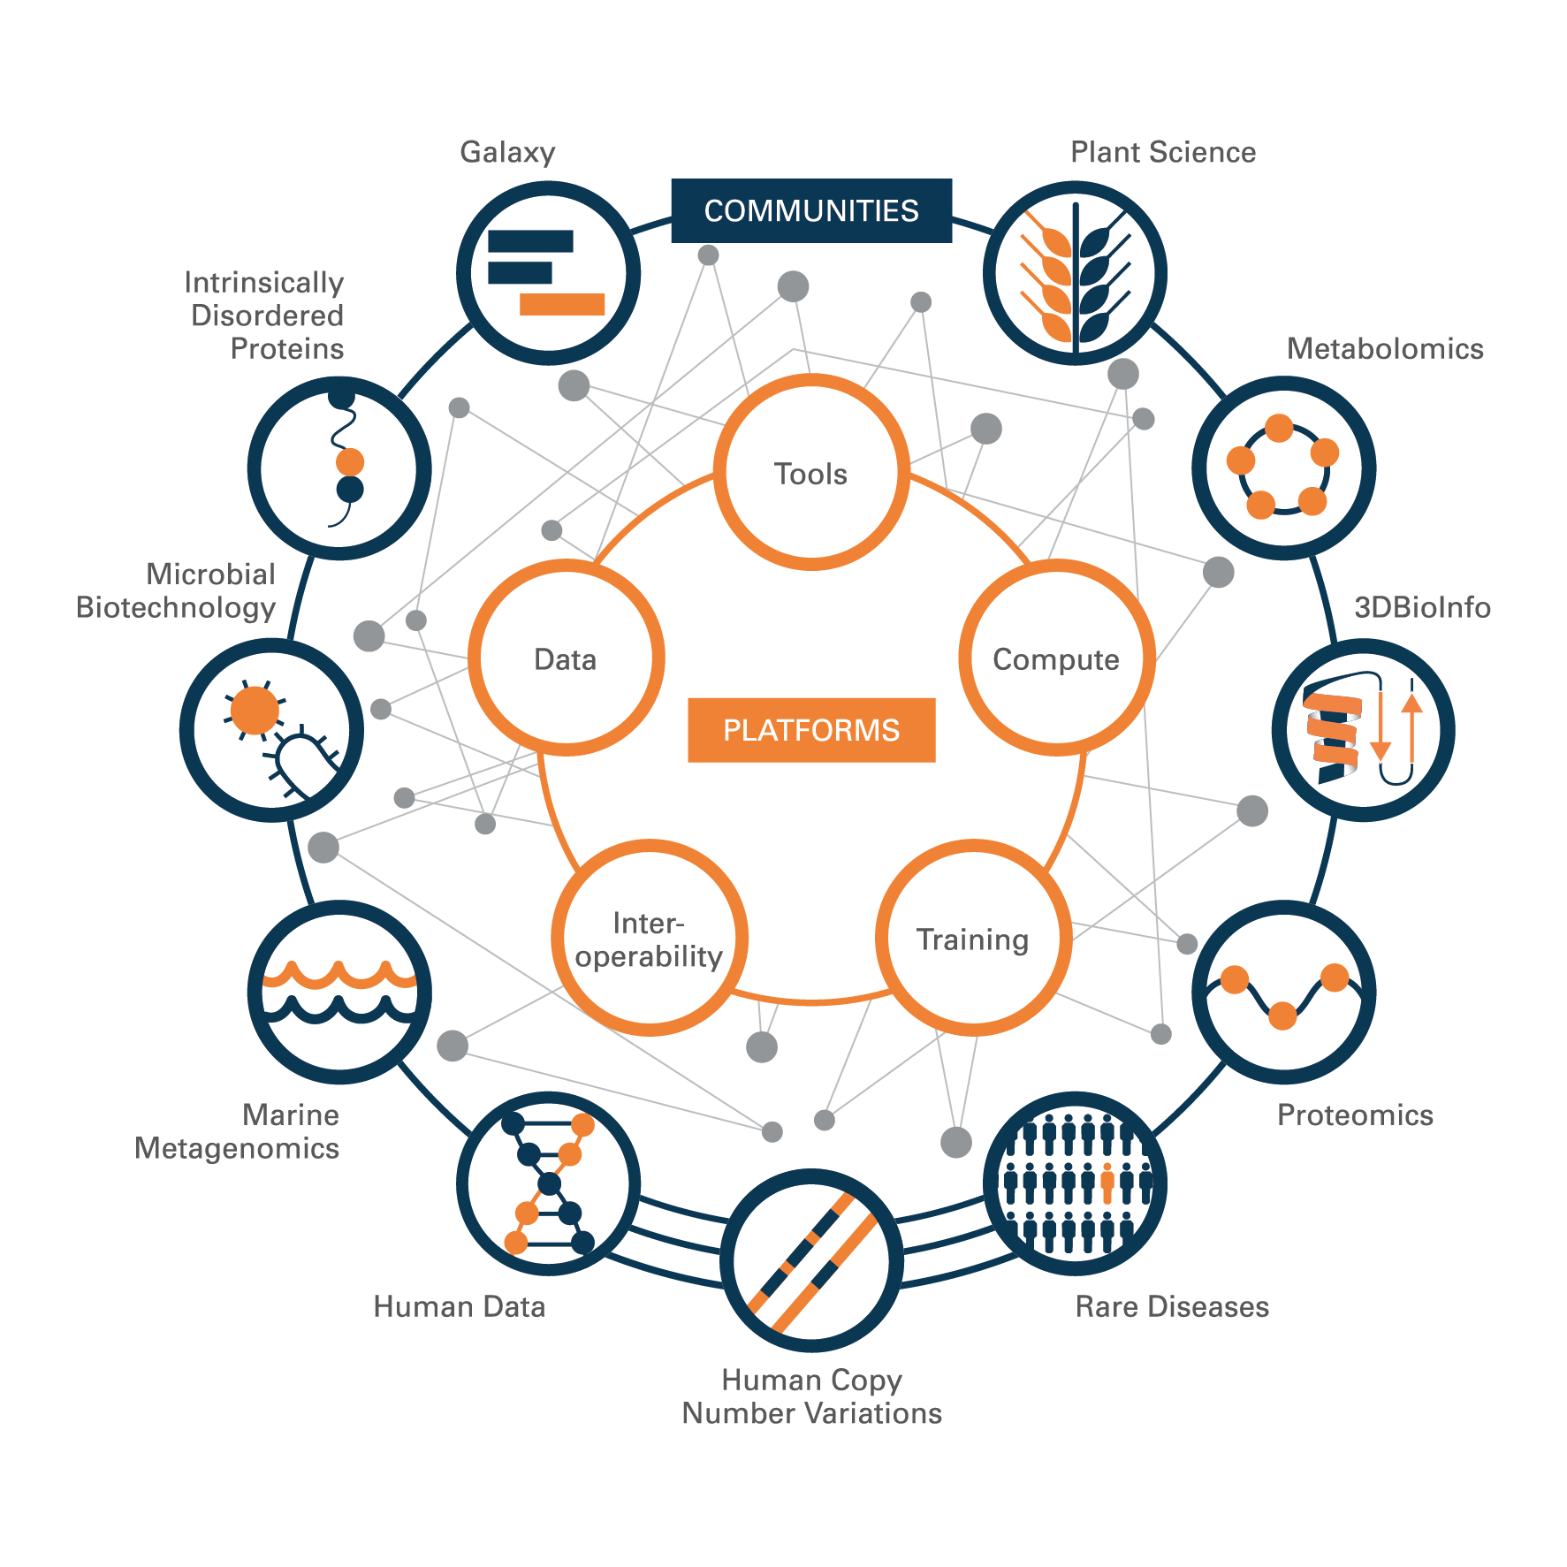
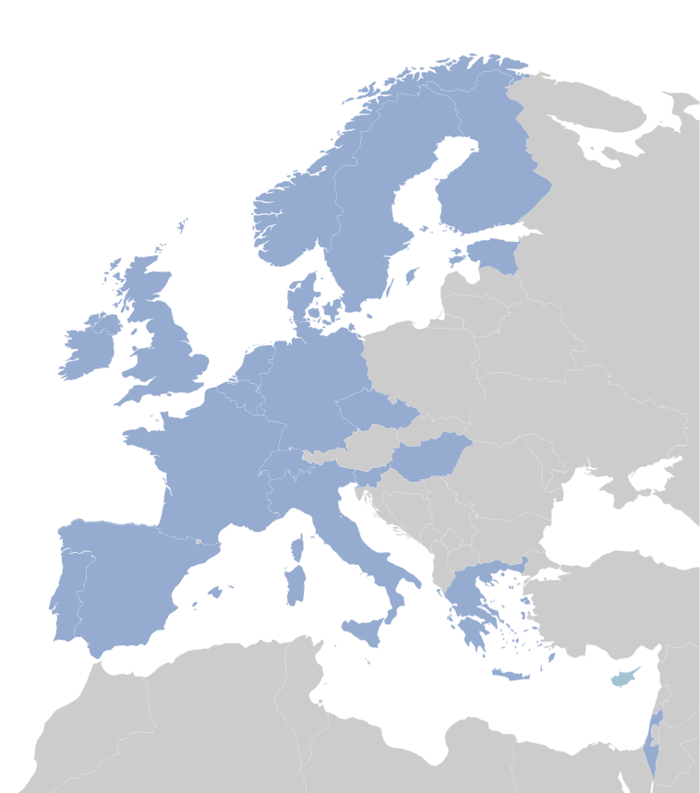
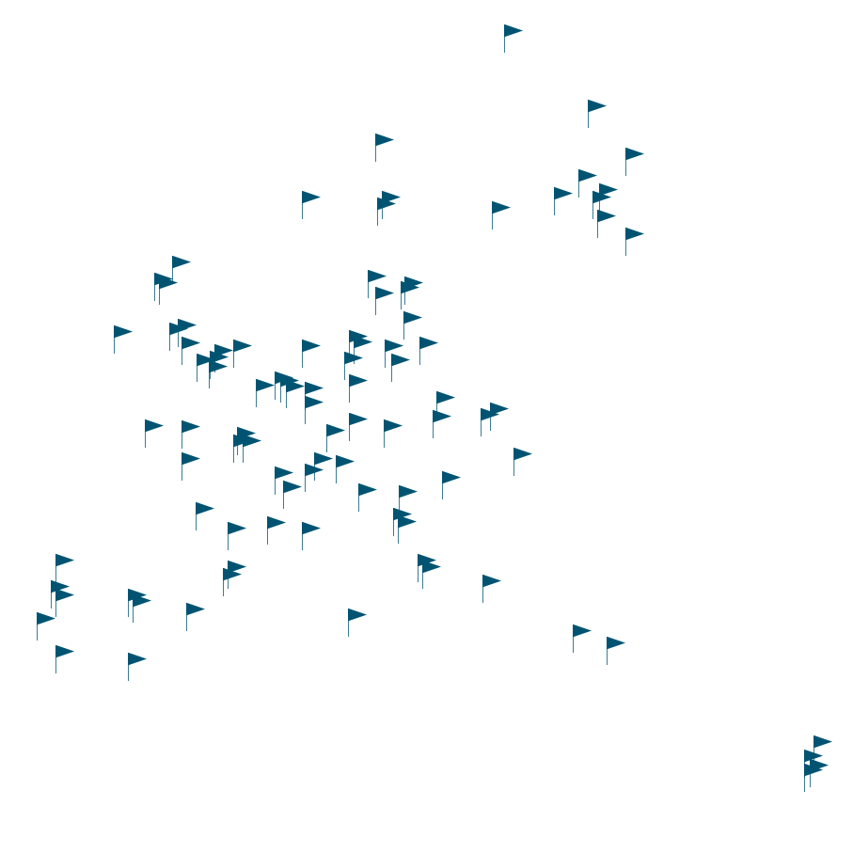
ELIXIR - A distributed infrastructure for Life Science data
Coordinated work across multiple locations
Work together to create common standards

Slide 3
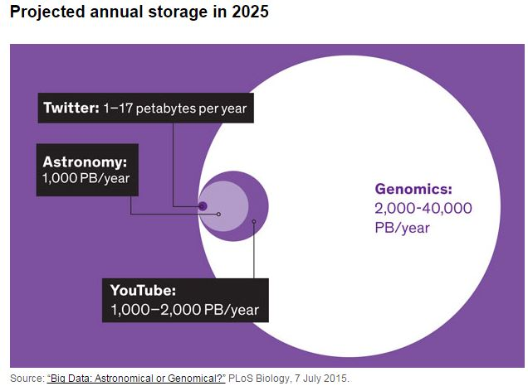
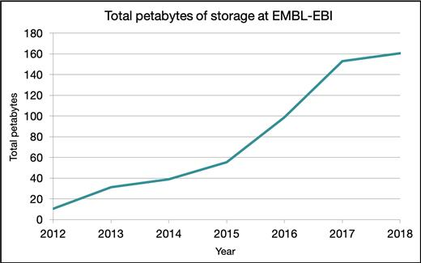
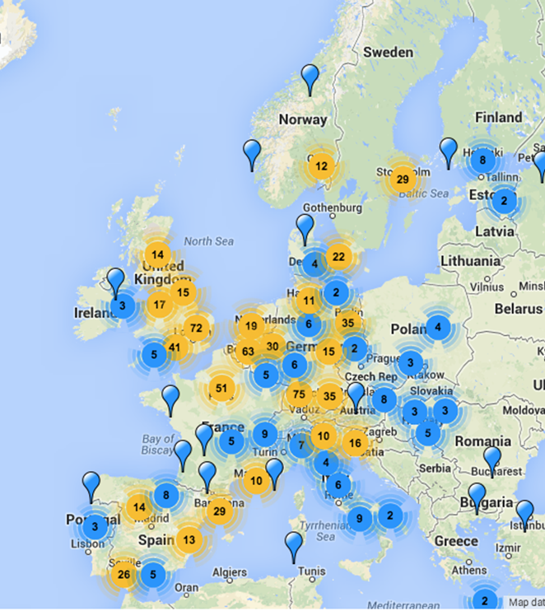
Why do we need ELIXIR?
Example: challenge with data storage
64 million requests for data per day
Notes:
Essential to standardise how we store data and metadata
Every second the total information produced in the world is one PB per second. 1 PB is equivalent to over 4,000 digital photos per day your entire life
Development in sequencing technologies is much faster than in computer hardware technologies – We will run out of storage
ELIXIR - driver for the use of common standards and ontologies

Slide 4
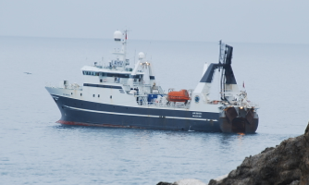
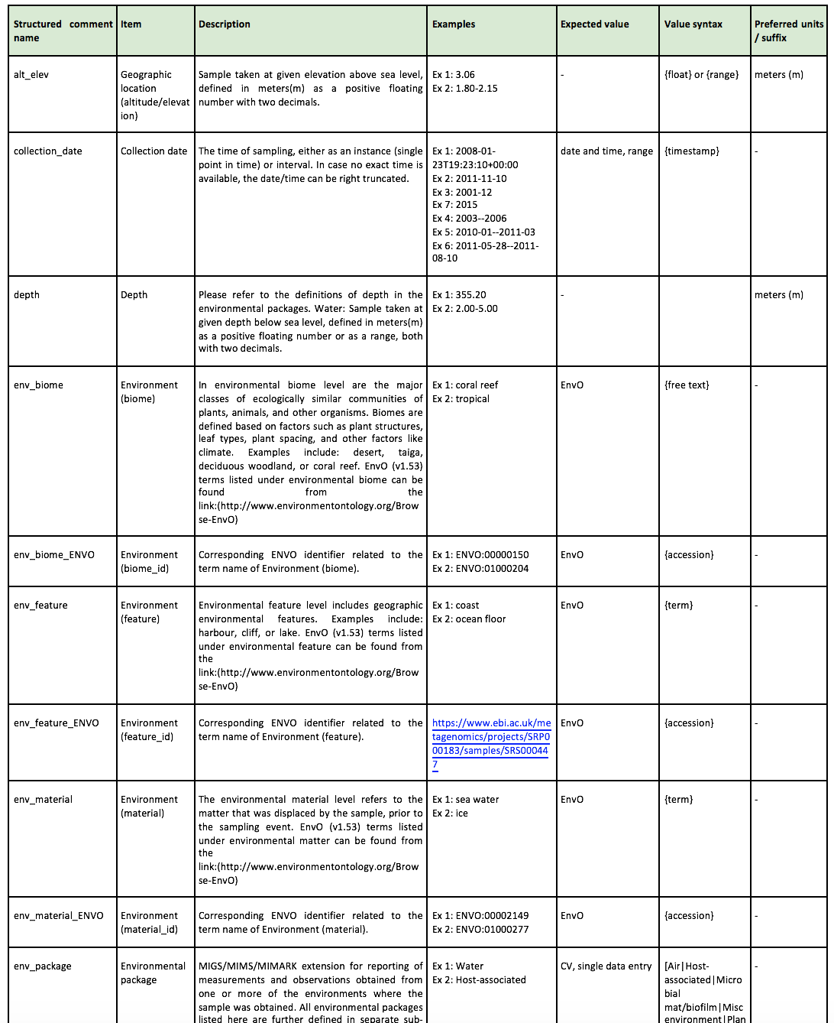
Why do we need ELIXIR?
Example: metadata standards and controlled vocabulary
c
->
->
->
->
->
->
->
->
->
->
->
->
->
->
->
missing
250
NA
missing
1
2
2901
0
582.80
0.04
missing
700
missing
0
0
Missing
Not collected
250 M
Not applicable
Superficial
-1 m
-2 m
-2901.0
0 m.
1912 ft
40 mm from surface
0.75 m above seafloor
700meters
Intracellular
Surface water of 0 meter
Zero
Below surface
c
Notes:
Sampling depth can be given in many different ways, and without a common standard (using a controlled vocabulary) it is impossible to compare data between studies using different ways of reporting metadata

Slide 5






ELIXIR Norway
Service and collaboration and support
Access to data, tools, compute & storage
Data management planning
Service and collaboration and support
Access to data, tools, compute & storage
Data management planning
DATA
DATA STORAGE
EXPERIMENT
DATA DEPOSITION
METADATA
DATA ANALYSIS

Slide 6




ELIXIR Norway
Service and collaboration and support
Access to data, tools, compute & storage
Data management planning
DATA
DATA STORAGE
EXPERIMENT
DATA DEPOSITION
METADATA
DATA ANALYSIS

Slide 7
Focus in this course
Service and collaboration and support
Access to data, tools, compute & storage
Data management planning
DATA
DATA STORAGE
EXPERIMENT
DATA DEPOSITION
METADATA
DATA ANALYSIS

Slide 8
Data storage in NeLS and StoreBioInfo (SBI)
Norwegian e-infrastructure for Life Sciences - developed and operated by Elixir Norway
NeLS in general
Available to all Norwegian researchers
Enable collaborative projects
Multiple storage layers
Integrated with compute
Multiple permission roles - shared data
Free of charge*
Support for data deposition
User support: Elixir Norway helpdesk
Type of data
Non-sensitive data
Support multiple data types
SEEK integration for metadata
NeLS
DATA
DATA STORAGE
DATA DEPOSITION
METADATA
DATA ANALYSIS

Slide 9
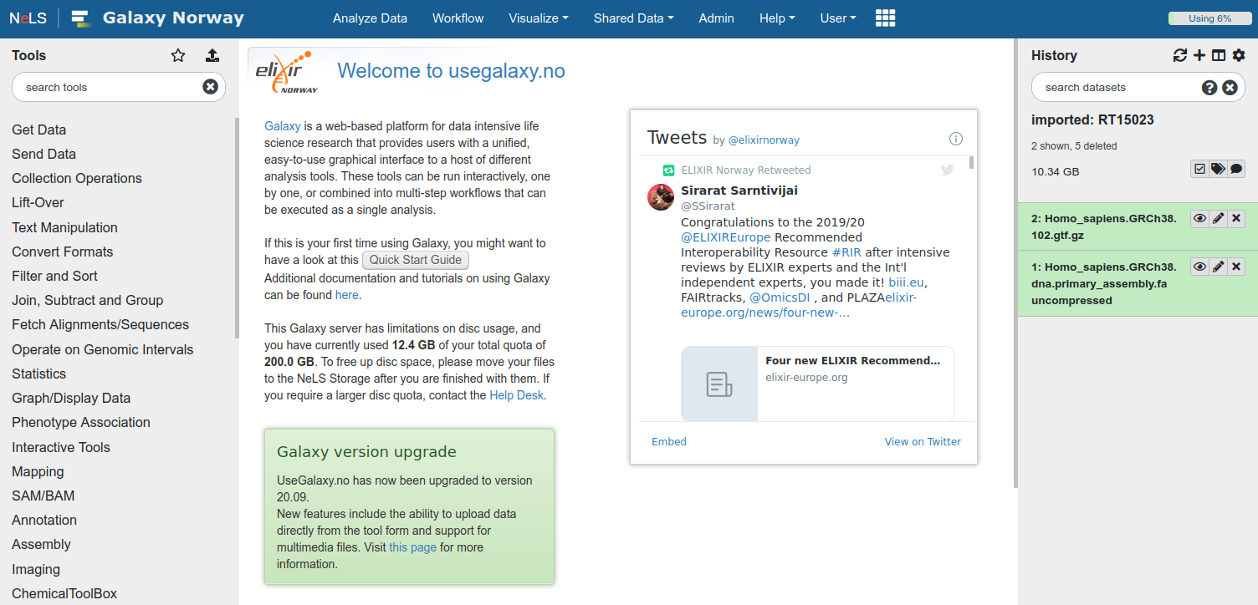
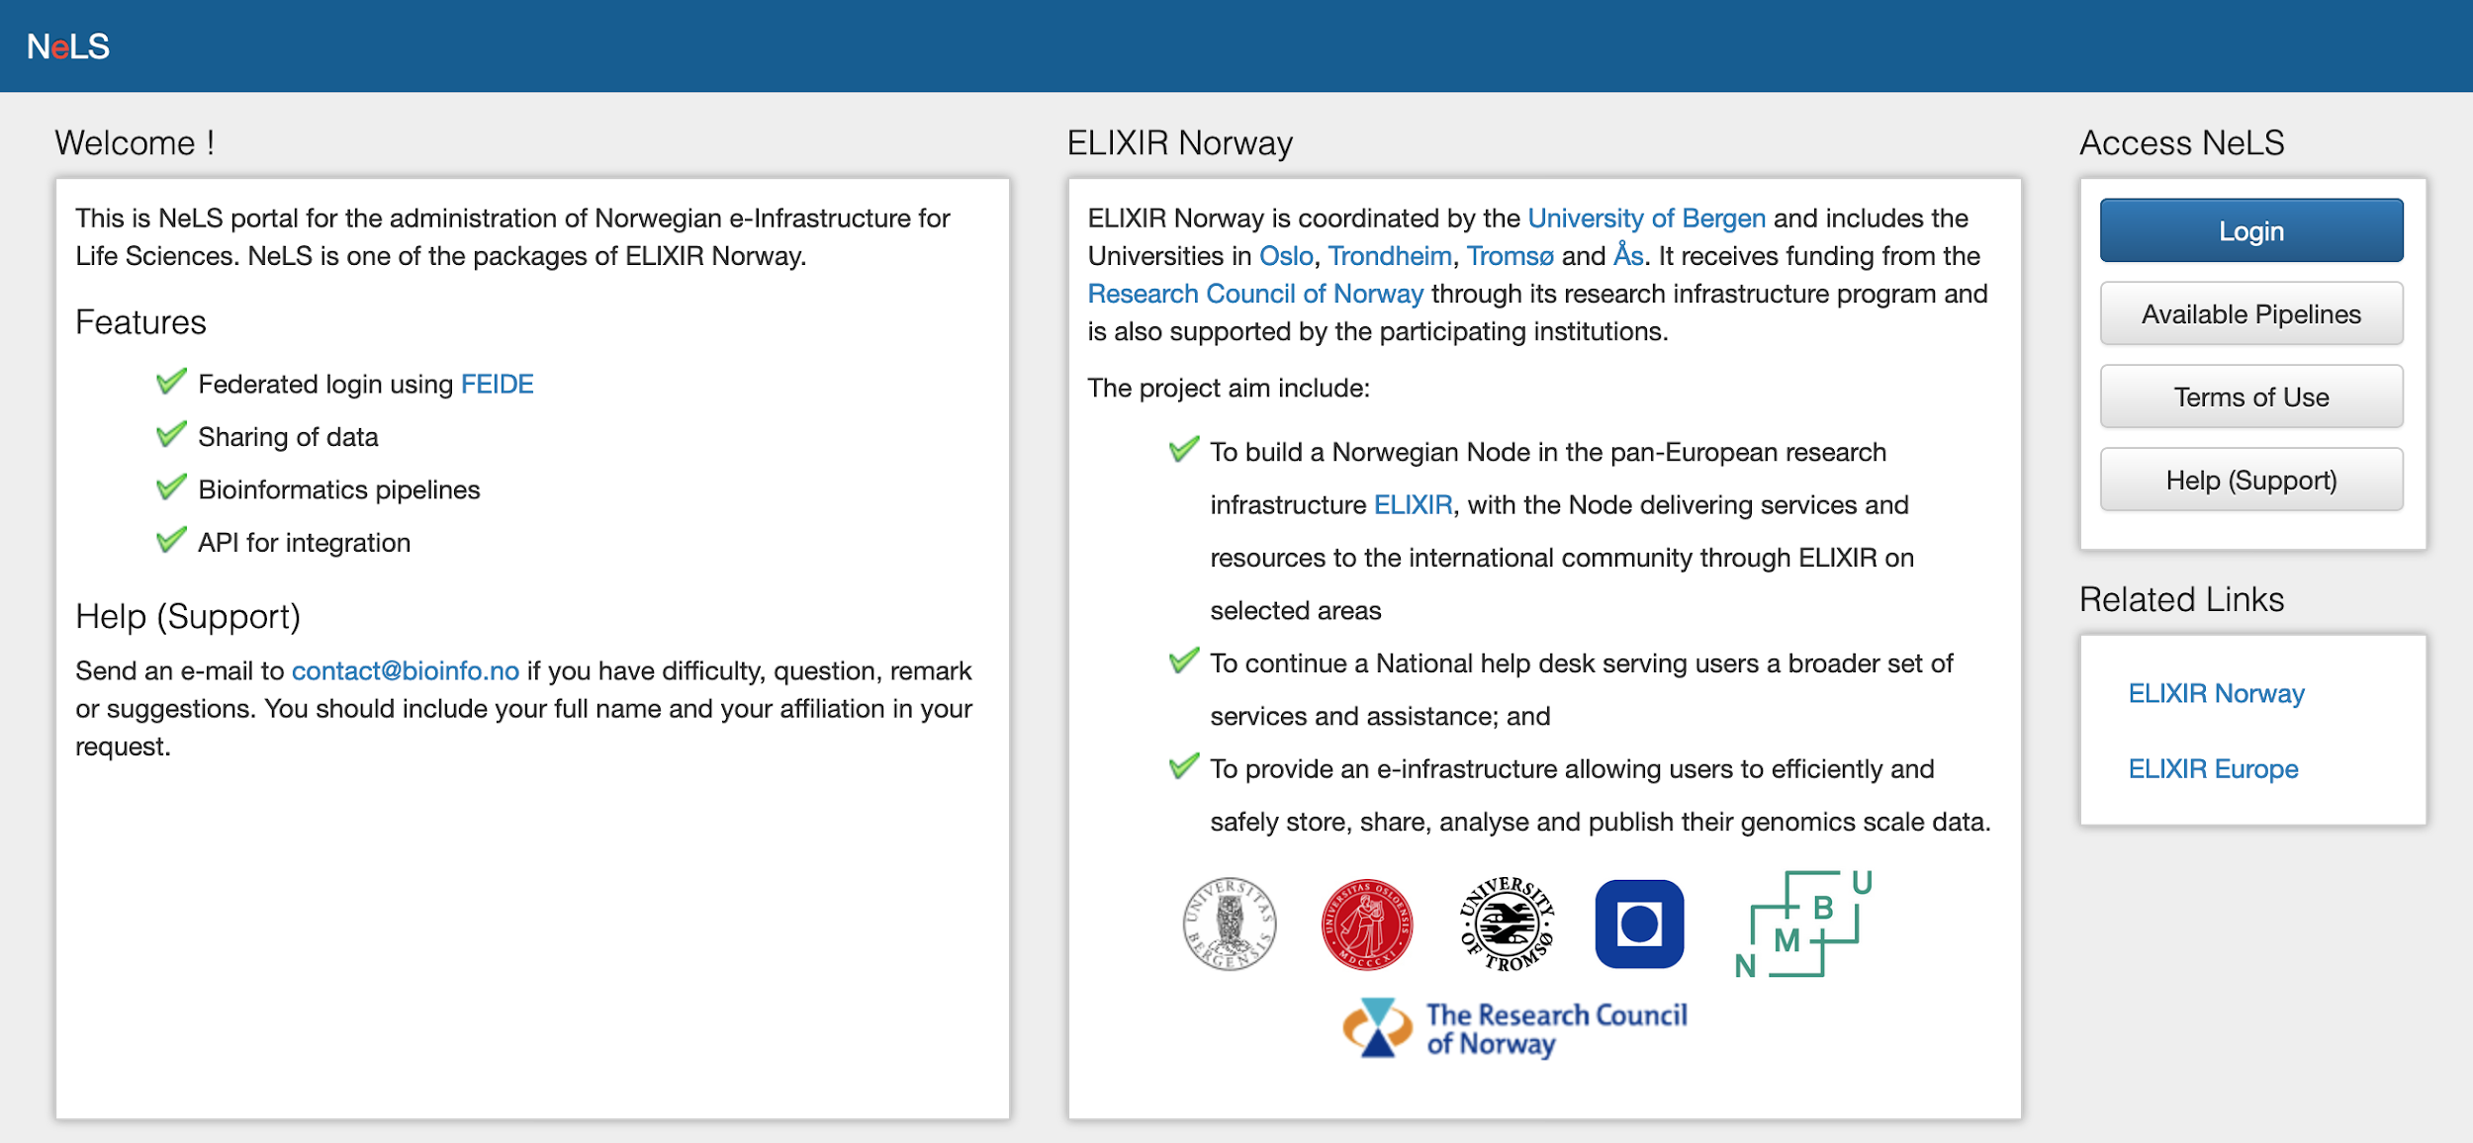
NeLS - Norwegian e-infrastructure for Life Sciences
+ https://usegalaxy.no
= https://nels.bioinfo.no
Access via FEIDE user or NeLS idp can be made for non-FEIDE users
Notes:
E-infrastructure provided to all Norwegian researchers within Life Sciences
For non-sensitive data. (Elixir Norway also support projects in TSD for sensitive data.)
Developed and operated by Elixir Norway, running on top of Elixir Norway servers as well as the generic storage services NIRD operated by Sigma2.
User support provided by the Elixir Norway helpdesk

Slide 10
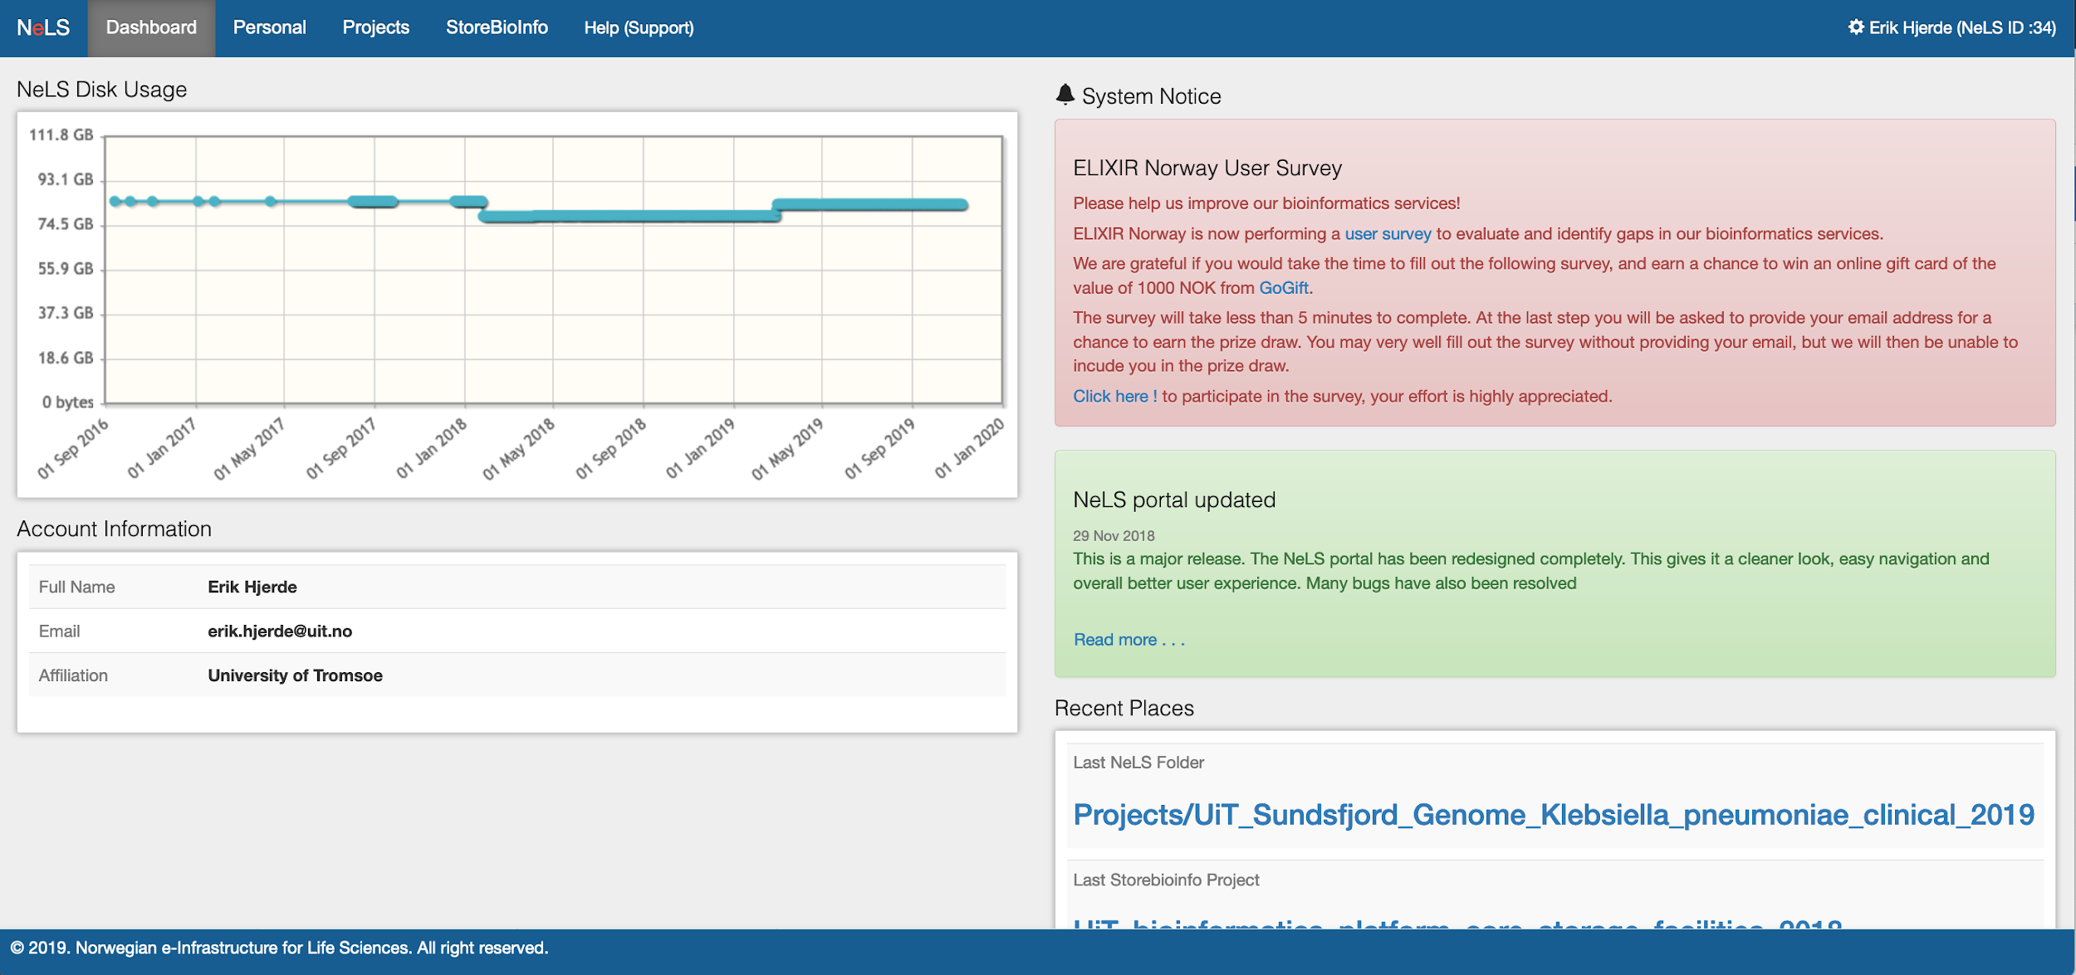
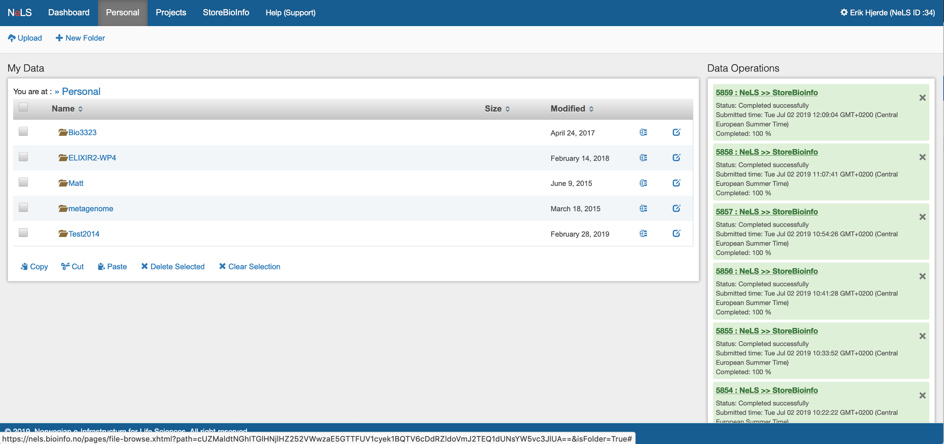
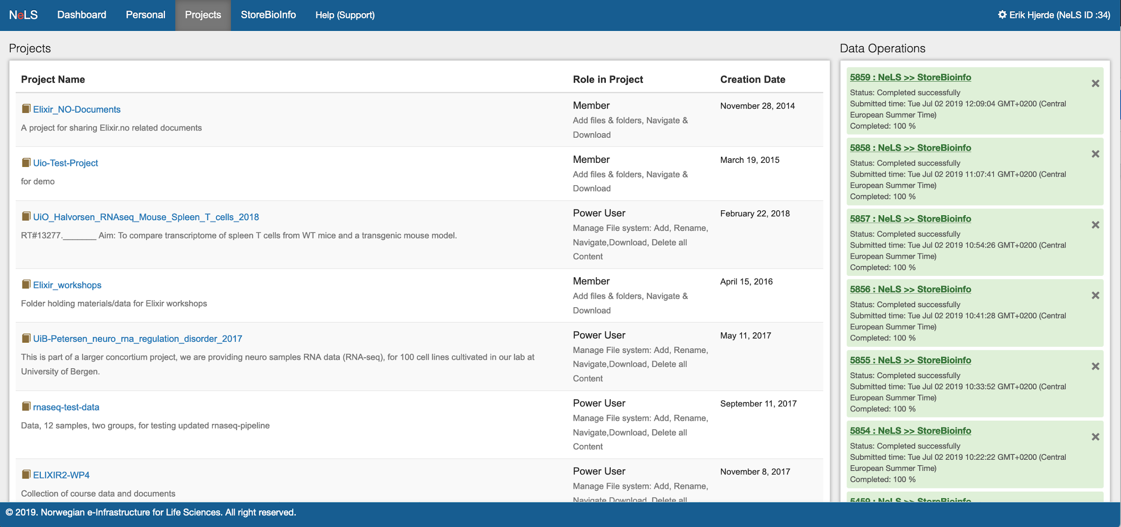
Access to storage and sharing of data in NeLS
Access to personal storage and projects and SBI
Storage application needed for projects where data is shared by many users
Access to personal storage and projects
Notes:
Managing data – different roles
Free storage < 10 TB

Slide 11
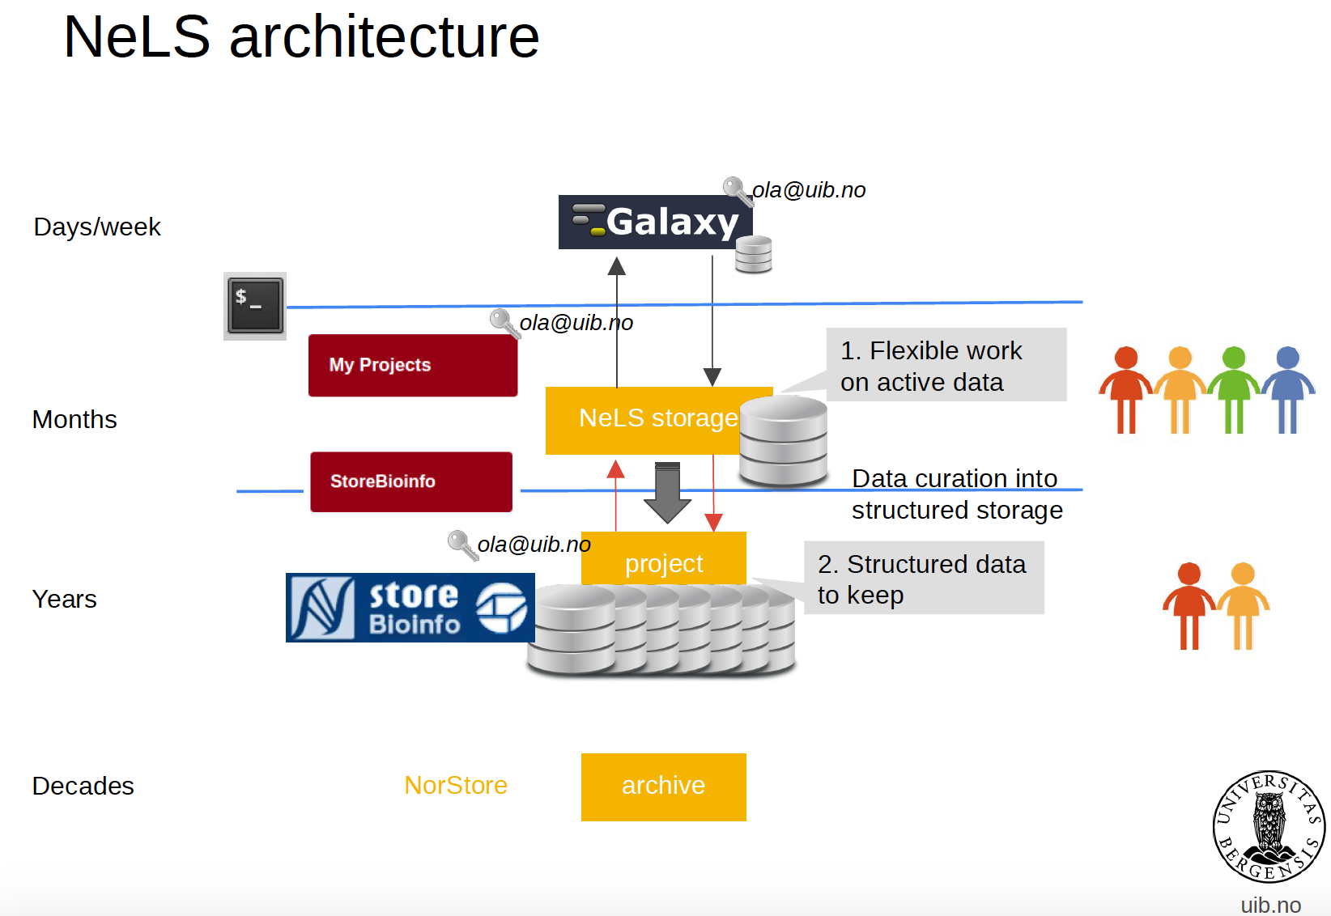





NeLS architecture
Research data archive

